Slide 1
Hurricane Preparedness 2026

Slide 2
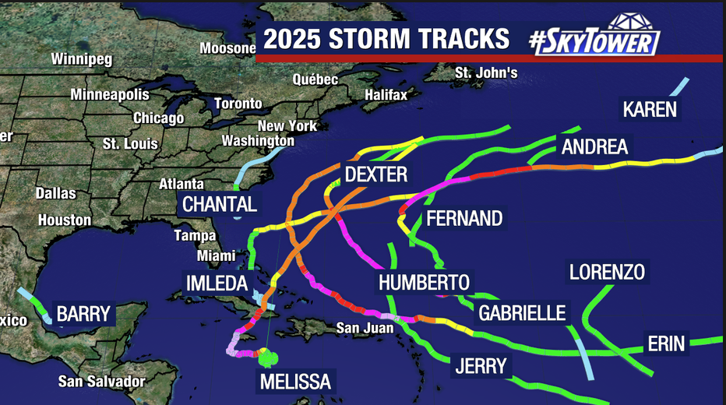
2025 Hurricanes in the Atlantic and Gulf of Mexico

Slide 3
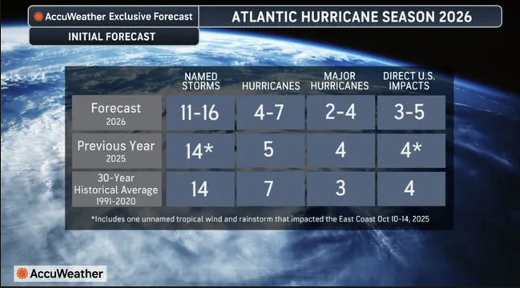

Slide 4
Hurricane Preparation
Tropical cyclones are categorized by wind speed:
Tropical Depression –
  An organized system of clouds and thunderstorms with a defined surface circulation and maximum sustained winds of 38 mph or less.
Tropical Storm –
  An organized system of strong thunderstorms with a defined surface circulation and maximum sustained winds of 39-73 mph.
Hurricane –
  An intense tropical weather system of strong thunderstorms with a well-defined surface circulation and maximum sustained winds of 74 mph or higher.
  Hurricanes will also be categorized to the strength of their winds using the Saffir-Simpson Hurricane Scale (Category 1 to a Category 5).

Slide 5
SAFFIR – Simpson Hurricane Wind Scale
CATEGORY | WIND/MPH | DAMAGE
CAT 1 | 74-95 | Moderate
CAT 2 | 96-110 | Extensive
CAT 3 | 111-130 | Devastating
CAT 4 | 131-155 | Catastrophic
CAT 5 | 155+ | Catastrophic

Slide 6
Hurricane Preparation
Watch vs. Warning – Know The Difference
Tropical Storm Watch –
  An announcement that tropical storm conditions (sustained winds of 39 to 73 mph) are possible within the specified coastal area within 48 hours.
Tropical Storm Warning –
  An announcement that tropical storm conditions (sustained winds of 39 to 73 mph) are expected somewhere within the specified coastal area within 36 hours.

Slide 7
Hurricane Preparation
Watch vs. Warning – Know The Difference
Hurricane Watch –
  An announcement that hurricane conditions (sustained winds of 74 mph or higher) are possible within the specified coastal area.
  Because hurricane preparedness activities become difficult once the winds reach tropical storm force, the hurricane watch is issued 48 hours in advance of the anticipated onset of tropical-storm-force winds.
Hurricane Warning –
  An announcement that hurricane conditions (sustained winds of 74 mph or higher) are expected somewhere within the specified coastal area.
  Because hurricane preparedness activities become difficult once the winds reach tropical storm force, the hurricane watch is issued 36 hours in advance of the anticipated onset of tropical-storm-force winds.

Slide 8
Hurricane Preparedness
National Hurricane Preparedness Week May 4 - 10, 2025
https://www.noaa.gov/hurricane-prep

Slide 9
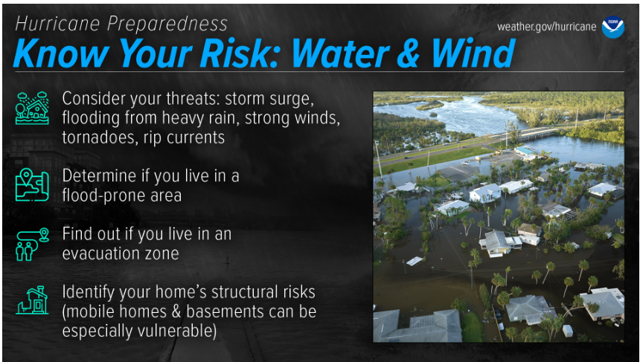
Floodsmart.gov: Understanding Flood Zones
NOAA’s Coastal Flood Exposure Mapper
HurricaneStrong: Find Your Evacuation Zone
NHC Storm Surge Hazard Maps
Find out today what types of wind and water hazards could happen where you live.
Hurricanes are not just a coastal problem. Impacts from wind and water can be felt hundreds of miles inland, and significant impacts can occur regardless of the storm’s strength.
Know if you live in an area prone to flooding, if you live in an evacuation zone, and identify any structural weaknesses in your home.

Slide 10
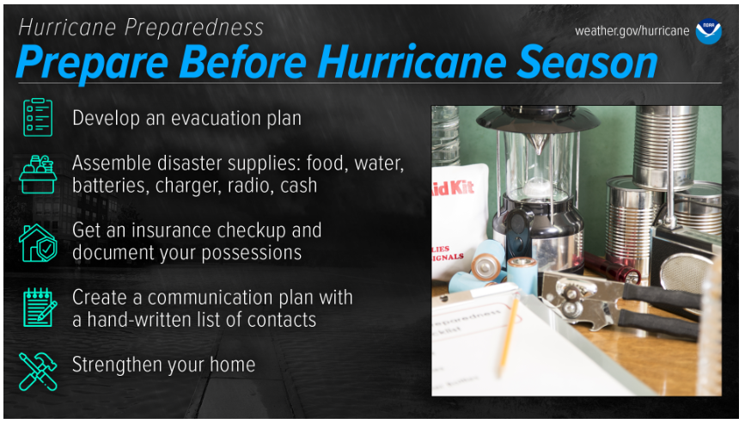
FEMA: Build a Kit
FLASH: Assembling A Disaster Kit
Ready.gov: Prepare Your Pets for Disasters
FLASH Insurance Guide: If Disaster Strikes, Will You Be Covered?
Find flood insurance at floodsmart.gov
FEMA: Make a Plan
FLASH: Family Disaster Plan
FEMA Mobile App & text for Shelter
FEMA: Tips to Prepare Your Home for Hurricane Season
FLASH video: Protect Your Home from Flood Damage
The best time to prepare is before hurricane season begins.
Avoid having to rush through potentially life-saving preparations by waiting until it’s too late.
Get your disaster supplies while the shelves are still stocked, and get that insurance checkup early, as flood insurance requires a 30-day waiting period.

Slide 11
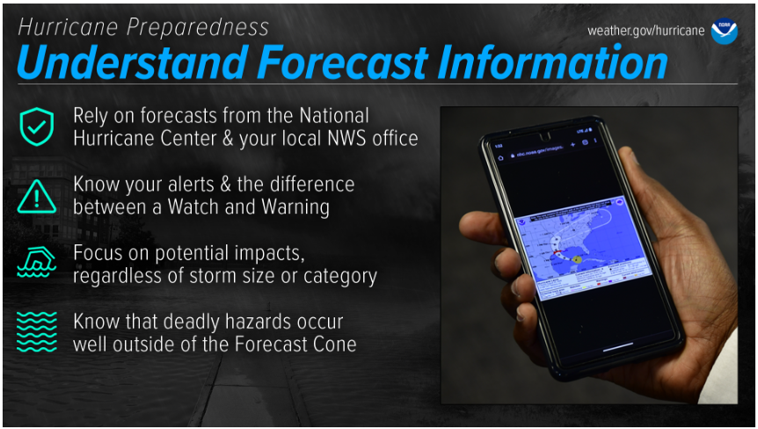
NOAA: Understanding Hurricane Forecasts & Impacts
NHC Video: How to use the cone graphic
National Weather Service forecast products can tell you a lot about what is expected to happen with a storm, including the storm’s paths, rainfall amounts, wind speeds, and more.
There is a lot of information available days ahead of a storm, and it is important to understand what it means.
Use the official National Hurricane Center Forecast

Slide 12
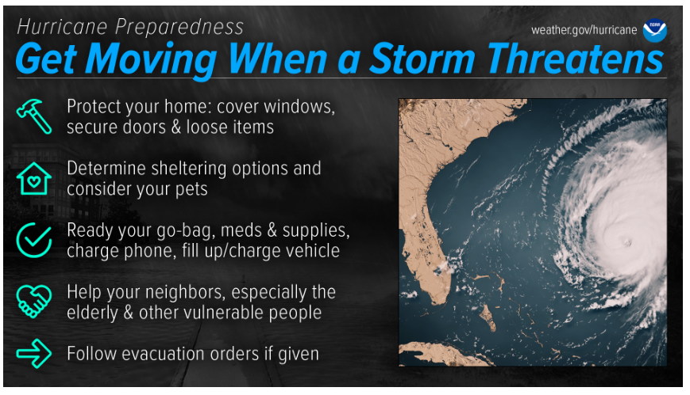
How-to: Protect Your Home in a FLASH
Download the FEMA App to find Shelter
FLASH: Find Your Evacuation Zone
https://www.ready.gov/evacuation
When a storm is forecast to impact your area, take action immediately to be ready.
Ideally, longer-term preparedness actions such as having disaster supplies and an evacuation plan will have already been done before hurricane season, when the stores are stocked and time is on your side.
When a storm threatens, there’s a lot more to do.

Slide 13
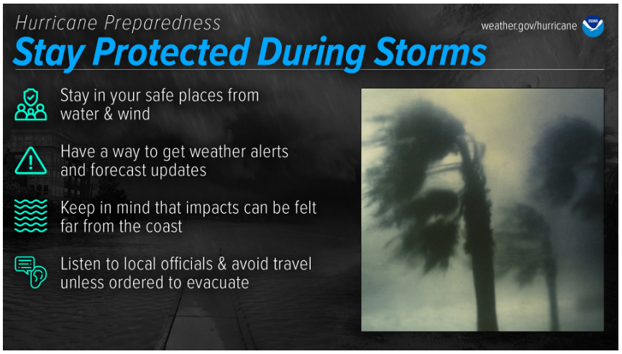
During a storm, whether you’ve evacuated or are sheltering in place, know what to expect from the hazards you may face.
Remain vigilant, stay up-to-date with the latest forecasts and alerts, and continue to listen to local officials.

Slide 14
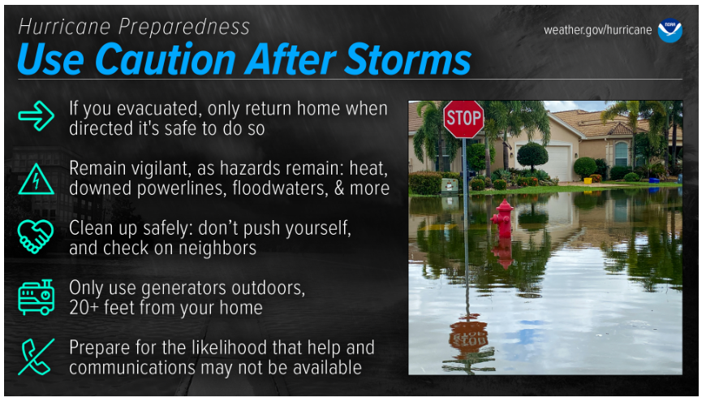
Dangers remain even after the skies turn blue.
This is NOT the time to put your guard down. Nearly half of hurricane fatalities occur after the storm.
If you evacuated, only return home only when told to do so
Return home ONLY when officials say it is safe.
​​Check with local officials both where you’re staying and back home before you travel.

Slide 15
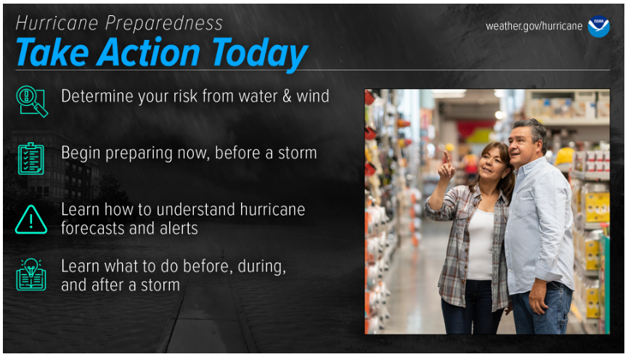
Are you ready for hurricane season?
Take action TODAY to be better prepared for when the worst happens.
Understand your risk from hurricanes and begin pre-season preparations now.
Make sure you understand how to interpret forecasts and alerts, and know what to do before, during, and after a storm.
Even if you are already well-prepared and knowledgeable, there may be additional things you could do or learn to be even more prepared.

Slide 16
Various Websites / Phone Numbers
Hurricane Preparedness
  https://www.noaa.gov/hurricane-prep
National Hurricane Center
  www.nhc.noaa.gov
Ready.gov
  https://www.ready.gov/make-a-plan
FEMA
  www.fema.gov/hazard/hurricane
  1-800-621-3362
American Red Cross
  www.redcross.org
KPRC
  https://www.click2houston.com/weather/kprcs-hurricane-flood-survival-guide
Weather Channel
  www.weather.com

Slide 17
Thank You

